Slide 1



The mythical senior developer
by Martin Chaov

Slide 2

Attention

Slide 3

How do you become a senior developer?

Slide 4
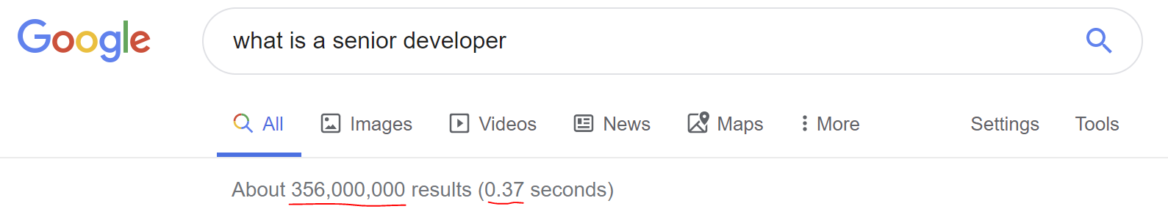

Slide 5
What does a senior developer do?
Write code
Design and implement software
Analyze data

Slide 6
What are the skills of a senior developer?
Knowledge of software development
Knowledge of computer languages
X years of coding
Databases
Exhibits Leadership Traits

Slide 7

Long time ago …

Slide 8

Today…
Millennials
Gen X
Gen Z
Whatever…

Slide 9


Slide 10


Slide 11

Notes:
At best you are going to be that guy …
Oops… not that guy… sec

Slide 12

Notes:
This guy… that’s more like it…

Slide 13

It’s been some time and we still don’t know what is senior developer…

Slide 14

The uncomfortable truth

Slide 15
A senior X is…

Slide 16

A player in an infinite game…

Slide 17



Slide 18
How to become one?

Slide 19

Define your goal

Slide 20

Be better tomorrow than you are today…

Slide 21


Slide 22
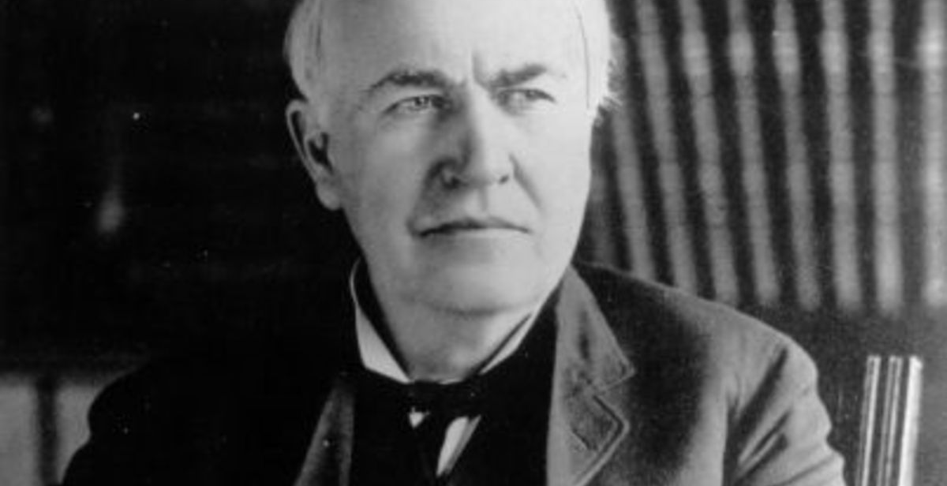
I have not failed. I've just found 10,000 ways that won't work.
Thomas Edison

Slide 23
Fixed Mindset
Ego driven
Growth Mindset
Intelligence and talents can be developed
Intelligence and skills are fixed
Failures define who you are
Hides flaws
Avoids challenges
Ignores feedback
Feedback = Criticism
Threatened by others’ success
Effort is the path to mastery
Mistakes are part of learning
Failure is an opportunity
Embraces challenge
Welcomes feedback
Others’ success is inspiration

Slide 24
Why develop growth mindset?
Unlock your potential
Strengthen your talents
Become more, do more, own more
Be an example for others to follow
Become more self-aware and humbler
Feel satisfied with who you are

Slide 25
How to develop growth mindset?
Introspection
Ensure space for vulnerability and failure
Life-long learning
Fail fast, fail often
Surround yourself with growth mindset
Become more humble
Ask for help
Find your place in the system

Slide 26


Slide 27
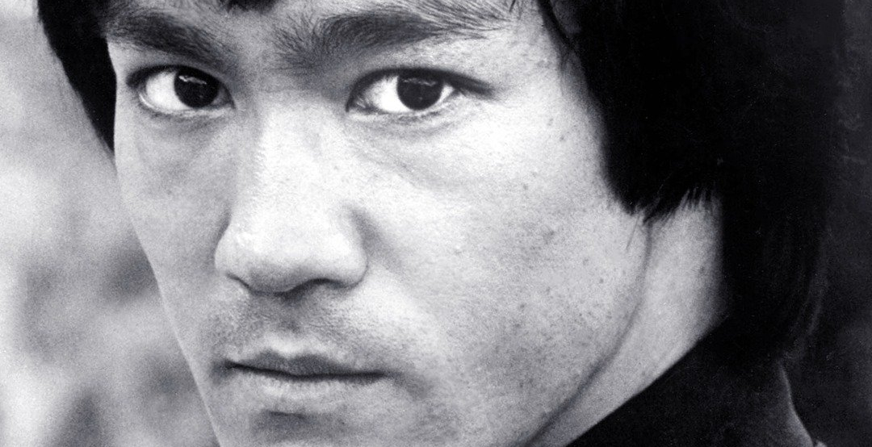
I fear not the man who has practiced 10,000 kicks once, but I fear the man who has practiced one kick 10,000 times.
Bruce Lee

Slide 28
Ask thyself…
What is important for you in your job?
What are your long-term goals?
What is your best skill?
What new skills do you need?
What is going to keep you motivated during the process?
How are you going to maintain your level of motivation?
Who can help you achieve your goal?
How are you going to celebrate?
How are you going to reward yourself on milestones?

Slide 29


Slide 30


Slide 31
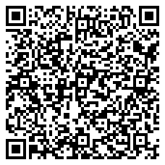
Connect ☺
LinkedIn: https://goo.gl/CRRJ2Y
Mail: martin@sbtech.com
Github: https://github.com/mchaov
@raziel_pld

